Slide 1
PHOTOSYNTHESIS and CELLULAR RESPIRATION
How energy is made within…..

Slide 2
Converting light energy into glucose
Photo = light
Synthesis = to make
Photosynthesis

Slide 3
…if he can do it, so can you!
http://www.youtube.com/watch?v=Y-8txUujHv0
Watch and learn!!

Slide 4


Let’s see what you remember…which of these is the correct photosynthesis formula?
6CO₂ +6H₂O = O₂ + C₁H₂₆O₆
C₆H₁₂O₆ + Light Energy + 6CO₂ →6H₂O
6CO₂ +6H₂O + Light Energy → C₆H₁₂O₆ + 6O₂
6O₂ +6H₂O + Light Energy → C₆H₁₂O₆ + 6CO₂

Slide 5
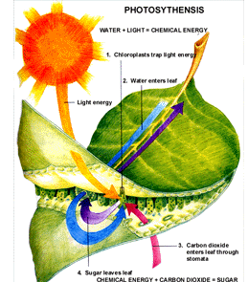
Photosynthesis Equation
6CO₂ + 6H₂O + Light Energy → C₆H₁₂O₆+ 6O₂

Slide 6
I. Biochemical Pathways
A series of reactions where one must depend on another
Ex: your kidneys must wait on you to drink fluids
Light Dependent Reaction
Calvin Cycle

Slide 7
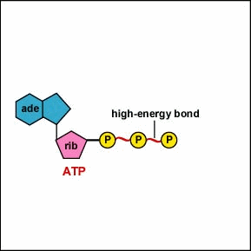
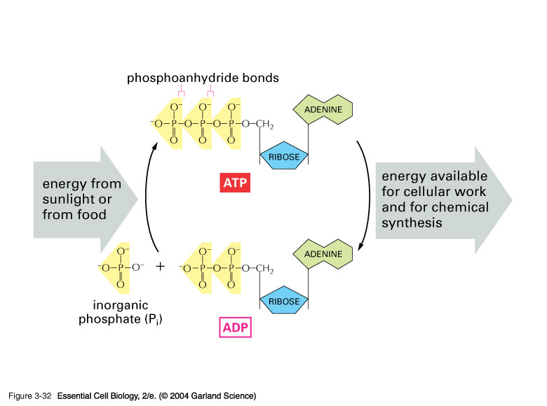
Chemical Energy
Adenosine Triphosphate (ATP)
Adenosine Diphosphate (ADP)
Principal compound used by cell to store and release energy
Compound similar to ATP minus a phosphate
Used by the cell to make ATP

Slide 8





II. Light Absorption
Photosynthesis (light reactions) occurs in chloroplast
Light waves travel as waves
  It appears white but is really
  ROYGBIV
  Chlorophyll: Pigment

Slide 9
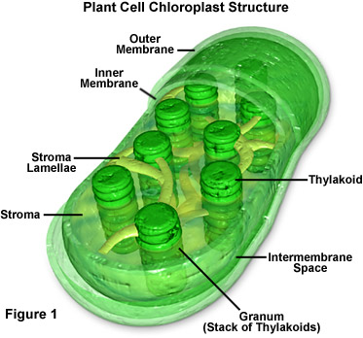
Thylakoids: saclike photosynthetic membranes
Granum: stack of thylakoids
Stroma: the spaceoutside the thylakoid membranes

Slide 10
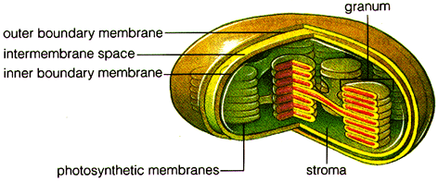
Photosystem
Organized clusters of proteins, chlorophyll, and other pigments found within the thylakoid membrane
Light-collecting units

Slide 11
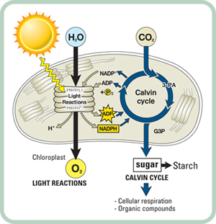
Overview of Photosynthesis

Slide 12
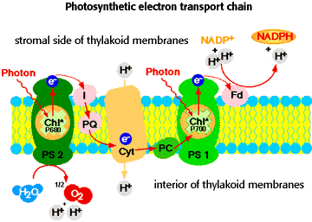
Electron Carriers
Electrons in the chlorophyll are so excited by the sun, they need special carriers to transport them in their high-energy state
Accepts and holds 2 high energy electrons along with a hydrogen ion
Electron Transport

Slide 13
Which of the following is true?
A thylokoid within the chloroplast represent a stack of grana.
Granum within the chloroplast represent stacks of thylakoids.
Chloroplast are green in color because they have green pigment inside of them called chlorophyll.
All of these are true
B and C are true

Slide 14
III. Photosynthesis Reactions
A. Light Dependent Reaction
B. Calvin Cycle
(light independent Reaction)
In Thylakoid Membrane
Needs Sun
Byproducts:
  ATP
  O₂
  NADPH₂ to send to Calvin Cycle
Occurs in Stroma
Does not need sunlight
Carbon Fixation occurs (putting carbon into molecules)
Byproducts:
  H₂O
  C₆H₁₂O₆
  RuBP to restart cycle

Slide 15
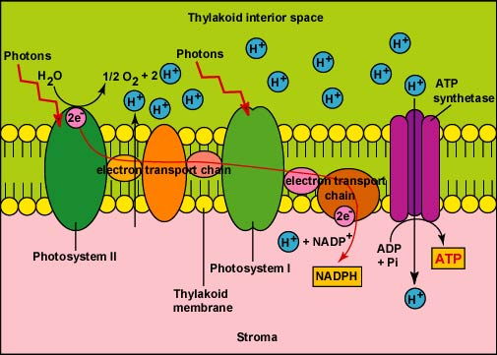
Light-Dependent Reactions

Slide 16
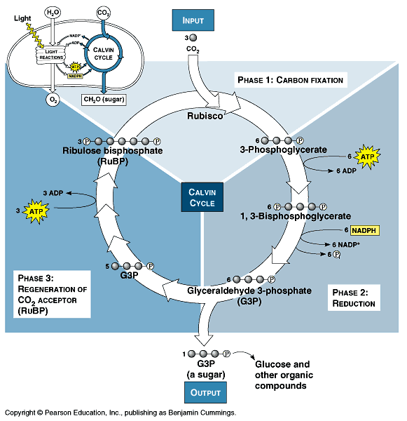
Calvin Cycle
Uses ATP and NADPH from light-dependent reactions to produce high-energy sugars

Slide 17
Which of the following is true of biochemical pathways?
C-4 and C-3 pathways are biochemical pathways that are waiting on the Calvin Cycle.
The Calvin cycle needs the light dependent reaction to occur , they are both dependent on each other.
The Calvin cycle is not part of photosynthesis and therefore not a part of a biochemical pathway.
None of these are true.

Slide 18


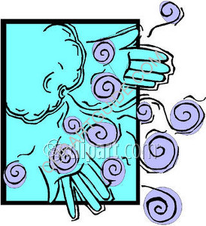
V. Rate of Photosynthesis
Rate is affected by:
1.
2. Temp
3. Carbon Dioxide
As all of these increase,
so does the rate of photosynthesis. They are directly proportional.

Slide 19
If the amount of light intensity increases, the rate of photosynthesis will increase.
True
False

Slide 20
Cellular Respiration
How animals make energy or ATP…..

Slide 21
Cellular Respiration and Photosynthesis Relationship
They are opposites in the energy world
CR occurs in animals in the mitochondria
PS occurs in plants in the chloroplast

Slide 22
The Connection…

Slide 23
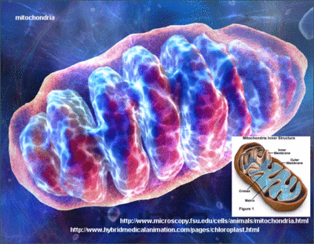
Cellular Respiration
Equation
C₆H₁₂O₆ + 6O₂→6CO₂ + 6H₂O + ATP

Slide 24
How are cellular respiration and phtosynthesis similar?
The both must take in carbon dioxide and release oxygen to produce energy.
They are both trying to produce energy within a cell while reciprocating their equations.
One process provides energy while the other uses energy.
They have no relationship at all.

Slide 25
Cellular Respiration
There are 3 main cycles where ATP is produced:
Glycolysis
Kreb’s Cycle
Electron Transport Chain

Slide 26
Cellular respiration occurs in which part of the cell?
The cytoplasm
The thylakioid
The mitochondria
Outside of the cell

Slide 27
Anaerobic vs. Aerobic
Anaerobic – do not require Oxygen
  Glycolysis
  Fermentation (ATP not made)
Aerobic – requires Oxygen to make ATP
  Kreb’s Cycle
  ETC (Electron Transport Chain)
Some cycles require oxygen some do not

Slide 28
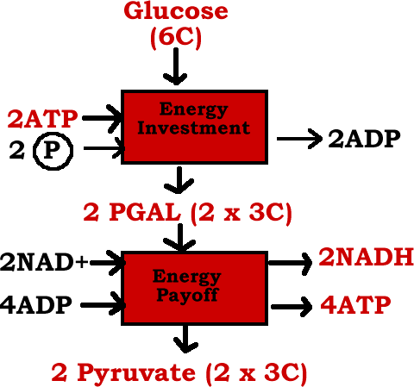
Glycolysis
Anaerobic
- C₆H₁₂O₆ (Glucose) is broken down into pyruvic acid
Net Gain:
2 ATP’s
2 NADH’s
2 Pyruvate’s

Slide 29
Is glycolysis a very efficient ATP producer?
Yes
No

Slide 30
Which of the following is true of aerobic and anaerobic respiration?
Anaerobic means that oxygen must be present for a cycle to occur.
Anaerobics is an exercise program for adults.
Glycolysis is anaerobic because it does not require oxygen to make ATP
None of these

Slide 31
By-pass
After Glycolysis,
When oxygen is not present, glycolysis is followed by a different pathway
fermentation
Anaerobic Process
Where No ATP’s are Produced

Slide 32

Alcoholic
Lactic Acid
Used for:
  Yeast in bread
  Wine
  Sauerkraut
Products:
  CO₂
  NAD
  Alcohol
Used by:
  Muscles when over exercised
Products
  NAD
  Lactic Acid
2 types Fermentation

Slide 33
What is true of fermentation?
It does not play a role in making ATP.
It is a stage where some cells go to but is not a main portion of cellular respiration.
It is a bypass stage, but is still important to us in different ways.
All of these

Slide 34
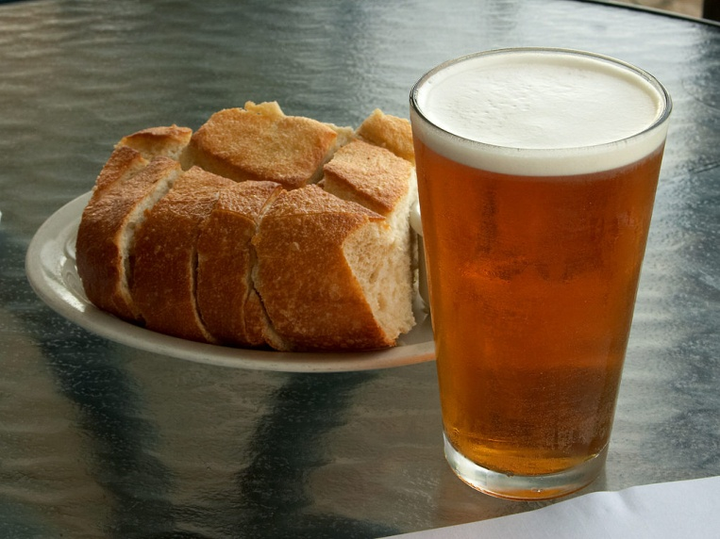
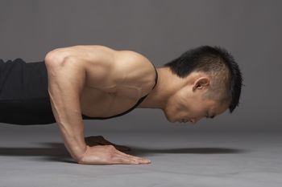
Fermentation
Bakers use the yeast made in alcoholic fermentation to make bread
Lactic acid made in the muscles start breaking down the muscles

Slide 35
Before Kreb’s Cycle but after Glycolysis
Before it can begin it must convert pyruvate into a more usable form.
This Nets 2 NADH’s
2 Pyruvic Acids 2 Acetyl CoA’s

Slide 36
Which of the following is not true?
Alcoholic fermentation can be used to make wine.
Yeast is used to make bread rise.
Lactic acid builds muscles by producing oxygen
Lactic acid is produced in muscles when over worked.

Slide 37
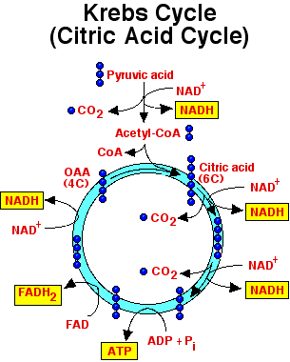
Kreb’s Cycle
Aerobic
AKA citric cycle
Occurs in mitochondria
Starts with 1 Acetyl CoA

Slide 38
Why must glycolysis occur before Krebs cycle?
Because these cycles are contingent on one another, meaning that one must occur producing something that the next needs.
These are biochemical cycles.
Glycolysis produces pyruvates, which inadvertently are used to start Krebs cycle.
All of these

Slide 39
Kreb’s Cycle
Net Gain after 2 cycles:
2 ATP
6 NADH
2 FADH₂
4 CO₂

Slide 40
Is the Krebs cycle a very efficient ATP producer?
Yes
No

Slide 41
Electron Transport Chain (ETC)
AKA Oxidative Phosphorylation
Looks like Fluid Mosaic Model
Where did they come from?
NADH:
2 Glycolysis
2 Pyruvate Conversion
6 Krebs cycle
FADH ₂:
2 Krebs cycle
It runs off of NADH and FADH₂ made in previous cycles.

Slide 42
How many ATP did glycolysis Net?
1
2
3
4

Slide 43
How many ATP did the Kreb’s cycle net?
1
2
3
4

Slide 44
ETC Summary
NADH and FADH₂ move across ETC allowing H to move down membrane
They release 2 electrons each time
Electrons pass down chain becoming excited producing ATPs

Slide 45
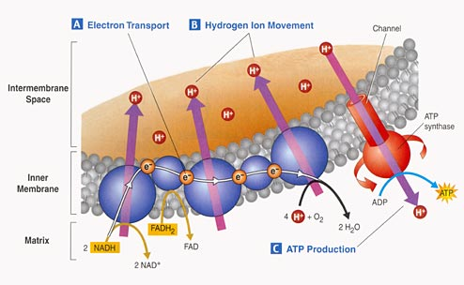
ETC

Slide 46
Energy Yield for 1 average cell in your body
Glycolysis | Kreb’s Cycle | Totals
2 NADH | 8 NADH | 2 NADH X 2 = 4 ATP 8 NADH X 3 = 24 ATP
0 FADH₂ | 2 FADH_{s} | 2 FADH₂ X 2 = 4 ATP
2 ATP | 2 ATP | 2 ATP + 2 ATP = 4 ATP
 |  | = 36 ATP

Slide 47

How many ATP did the ETC make on its own, not including the ones from other cycles?
0
20
32
36

Slide 48
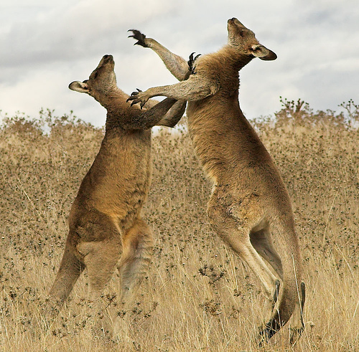

SHOW DOWN!!!

Slide 49
RULES!!!
Create a diagram summarizing photosynthesis and cellular respiration
NO BOOKS OR NOTES!!!
You must include, but are not limited to the following:
Photosynthesis | Cellular Respiration
Equation | Equation
Location of Light Reaction | Location of Glycolysis
Location of Calvin Cycle | Location of the Kreb Cycle
Products of Light Reaction | Products of Glycolysis
Products of Calvin Cycle | Products of Kreb Cycle
 | Purpose of Fermentation
 | Two Types of Fermentation

Slide 50
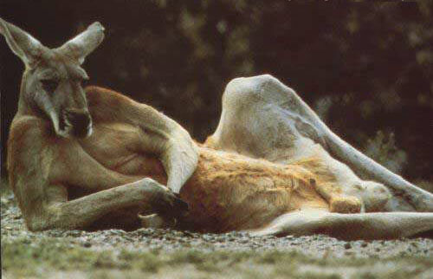

PRIZES!!!
1st Place: 10 pts!!!
2nd Place: 5 pts!!!
3rd Place:…Thanks

