Slide 1
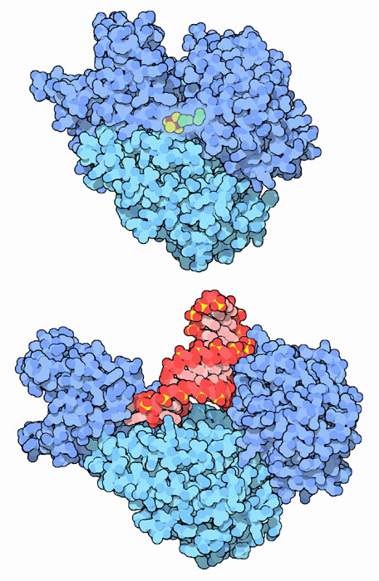
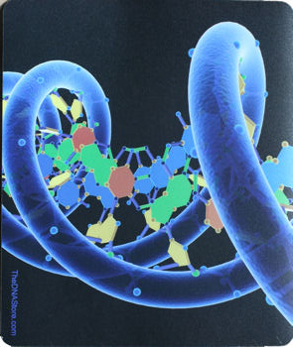
Why RNA?
DNA
Protein
Genes: coded DNA instructions that control the production of proteins within the cell

Slide 2
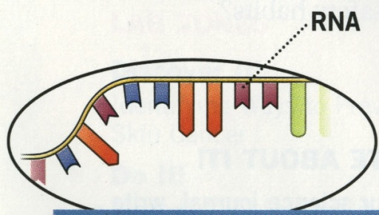
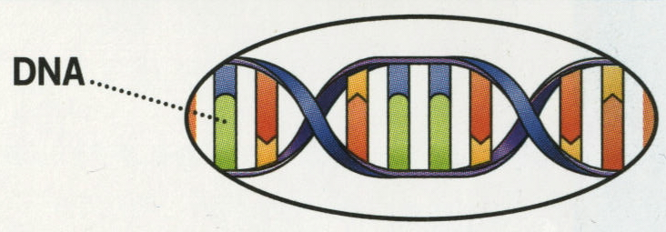
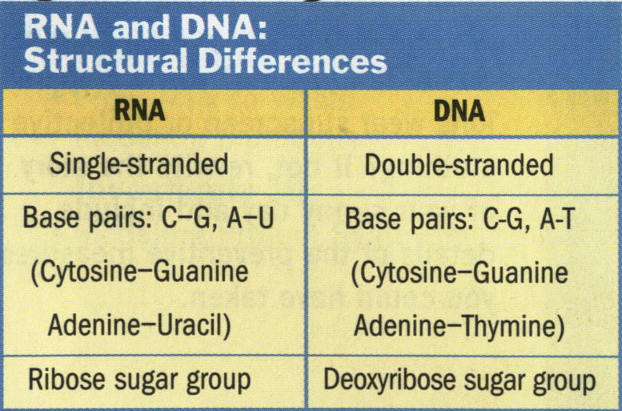
There are three main differences between RNA and DNA
The sugar in RNA is ribose sugar instead of deoxyribose in DNA
RNA is a single strand instead of a double strand in DNA
RNA contains adenine, guanine, cytosine and uracil as nitrogen bases
The uracil replaces the thymine found in DNA

Slide 3
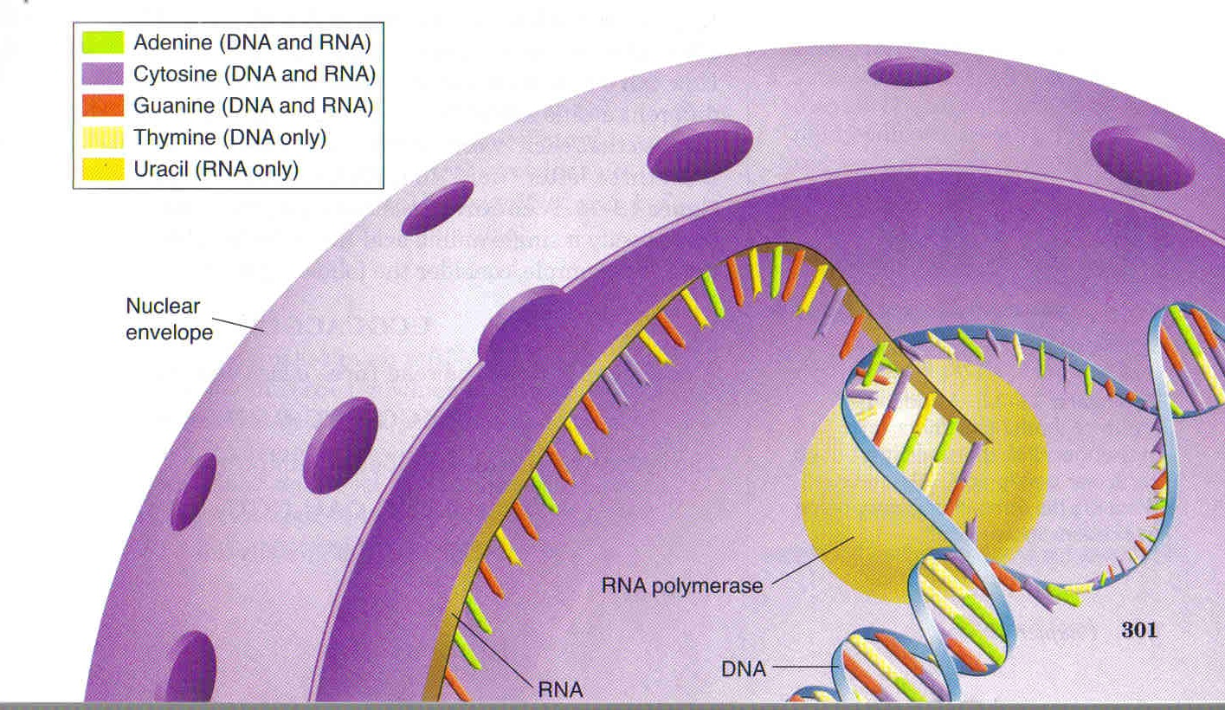
RNA acts as a working copy of a single gene from the DNA
The RNA that carries the DNA message from the nucleus is called messenger RNA (mRNA)
This process is called transcription
A protein called RNA polymerase separates the DNA strands and assembles the RNA strand

Slide 4
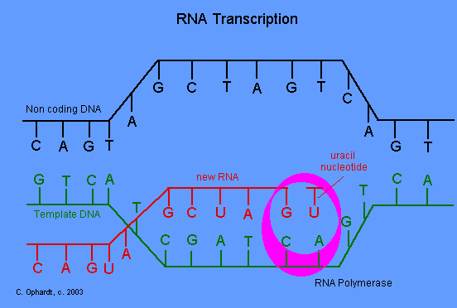
Transcription

Slide 5
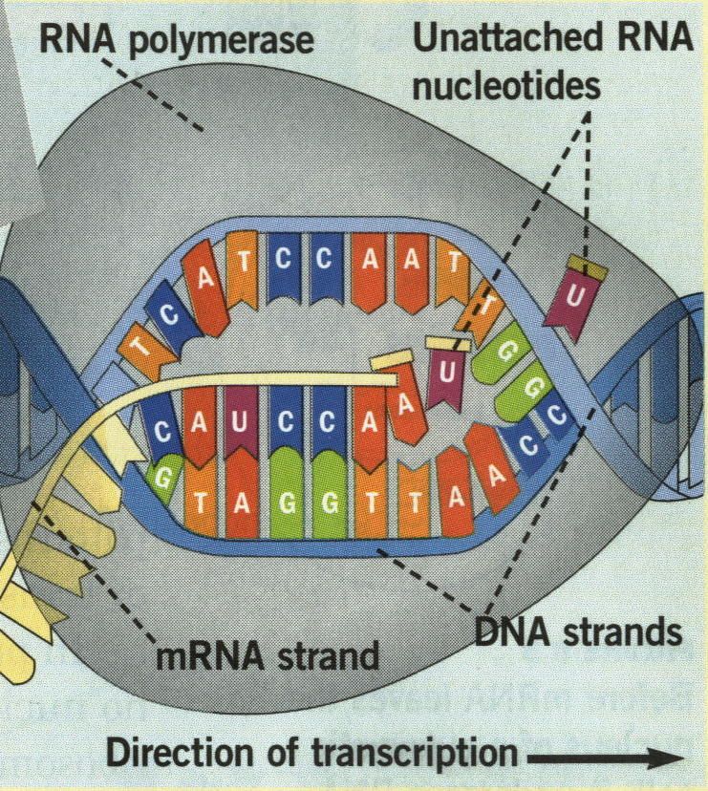
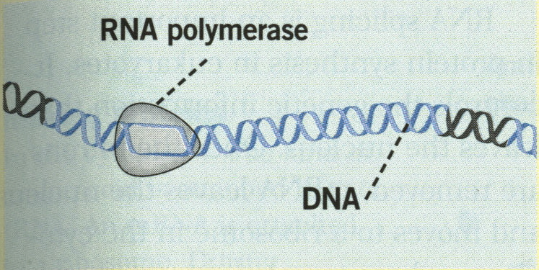
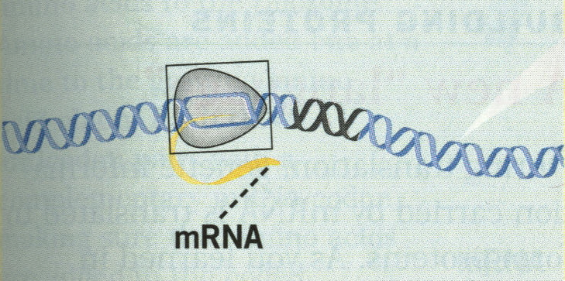
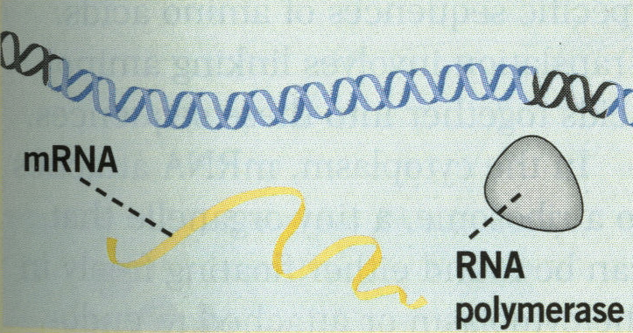
The RNA polymerase can find the proper starting point of the long DNA strand by finding the region that has a specific sequence known as promoters
It stops copying the DNA when it reaches the stop code for the gene

Slide 6
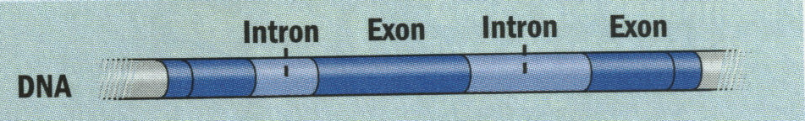
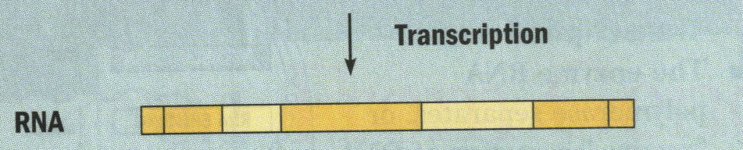
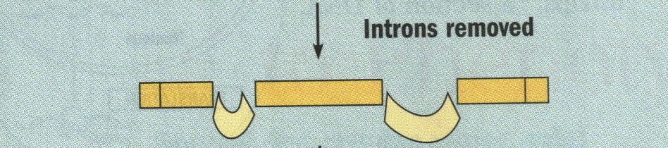
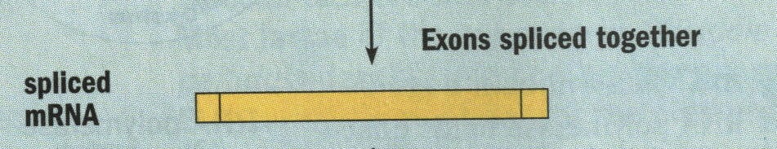
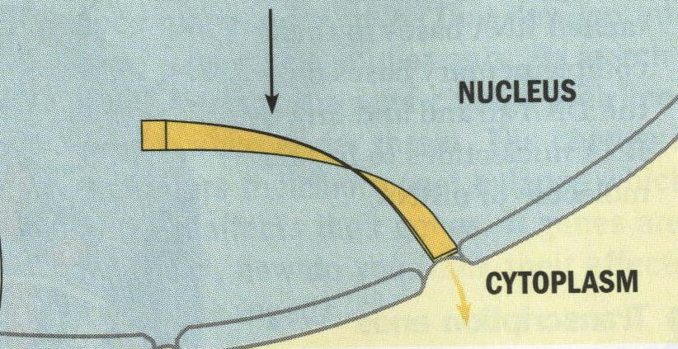
The DNA strand contains non-coding regions called introns and coding regions called exons
The new RNA strand must be edited by removing the introns and then splicing back together the exons.
Then the new mRNA copy can leave the nucleus for the next step of assembling proteins

Slide 7
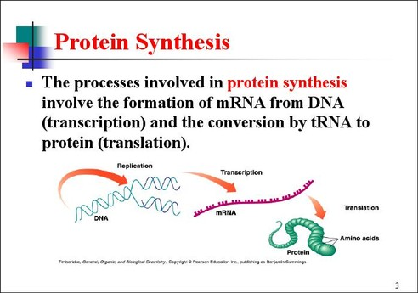

Slide 8
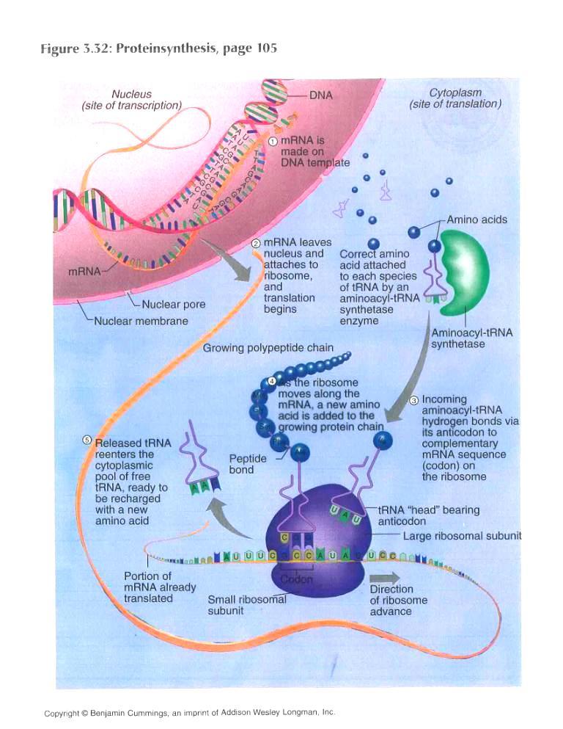
Protein
Synthesis
Overview

Slide 9
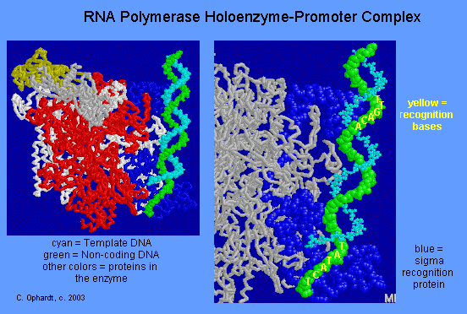
RNA Transcription
RNA polymerase and elongation reaction

Slide 10
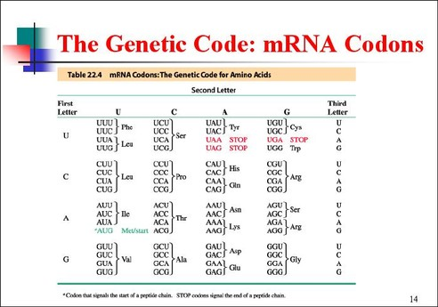
Messenger RNA
mRNA contains codons which code for amino acids
Codon-three consecutive nucleotides that specify a single amino acid

Slide 11
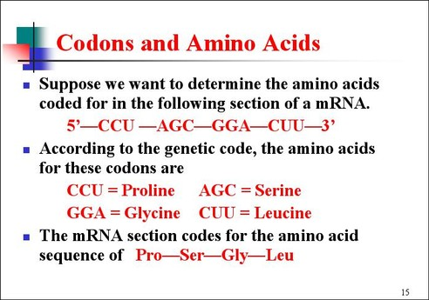

Slide 12
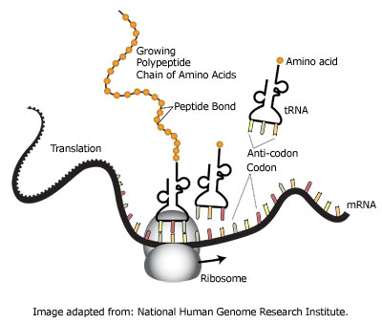
Translation
Occurs in the cytoplasm, on ribosomes

Slide 13
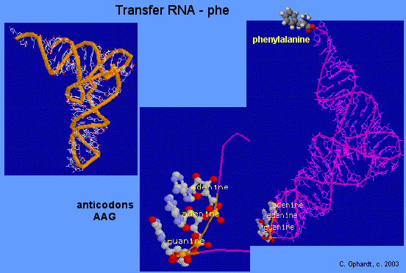
Transfer RNA
tRNA - Transfer RNA carries amino acid and reads codons on m-RNA through its own anticodons.

Slide 14
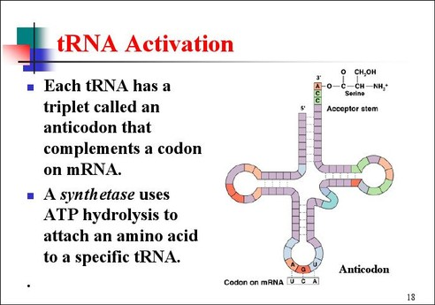

Slide 15
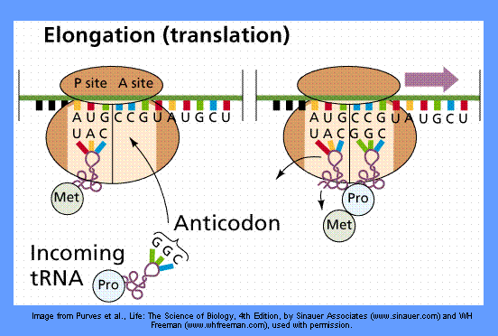
Protein Synthesis

Slide 16
Protein Synthesis

Slide 17
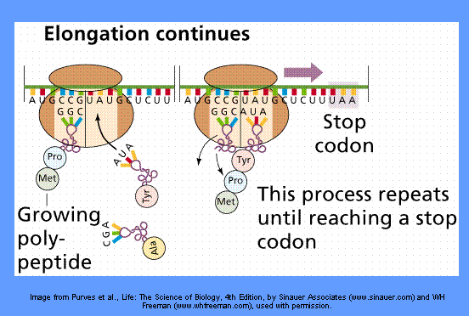
Protein Synthesis

Slide 18
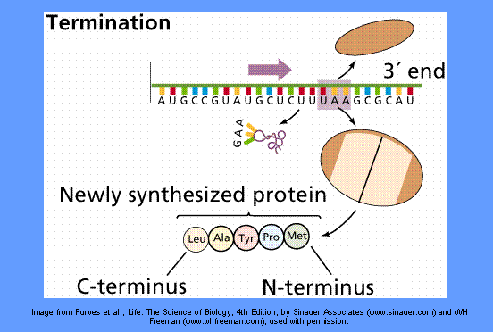
Protein Synthesis

Slide 19
