Slide 1
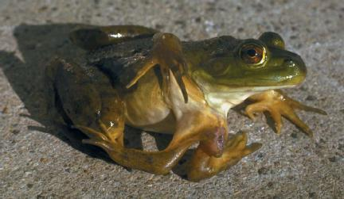
Mutations
Changes in the genetic material
Gene Mutations
Chromosomal Mutations

Slide 2
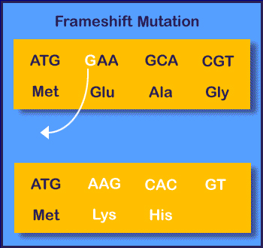
Gene Mutations
Point Mutations
Frameshift Mutation
They occur at a single point in the DNA sequence
Substitution
Insertion
Deletion
“Reading frame” of the genetic message is shifted because of the adding or deletion of a nucleotide
Can alter a protein so much that it is unable to perform its normal functions

Slide 3
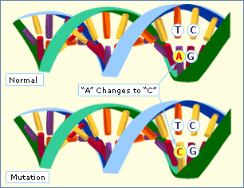
Substitution
Involve changes in one or a few nucleotides

Slide 4
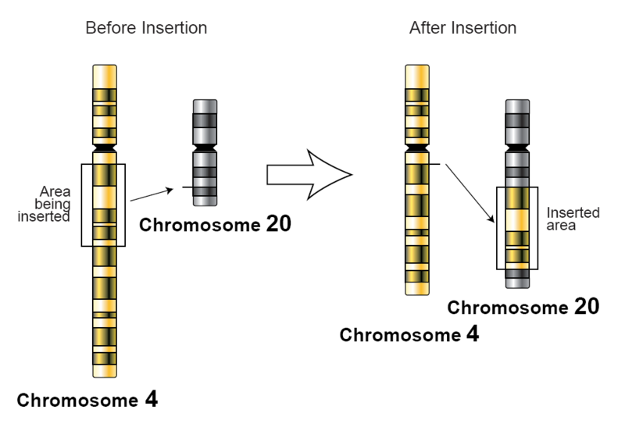
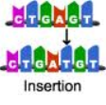
Insertion
The addition of one or more nucleotide base pairs into a DNA sequence.

Slide 5
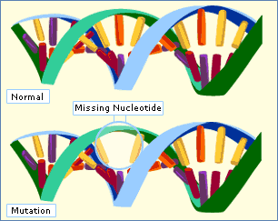
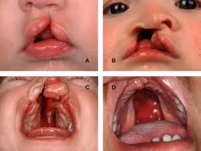
Deletion
Deletion Syndrome
Common signs and symptoms include heart abnormalities that are often present from birth, an opening in the roof of the mouth (a cleft palate), and distinctive facial features.
Part or all of the chromosome is lost

Slide 6
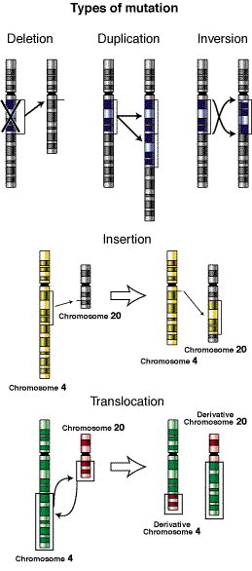
Chromosomal Mutations
Involves changes in whole chromosome
Deletion
Duplication
Inversion
Translocation

Slide 7
Deletion
Involves the loss of all or part of a chromosome

Slide 8
Duplication
Produces extra copies of parts of a chromosome

Slide 9
Inversion
Reverses the direction of parts of chromosomes

Slide 10
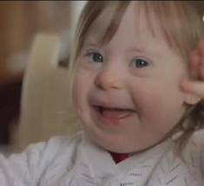
Translocation
Robertsonian Translocation Down Syndrome
Part of one chromosome breaks off and attaches to another

Slide 11
Significance of Mutations
Many, if not most, mutations are neutral.
They have little or no effect on the expression of genes or the function of proteins for which they code.
Harmful mutations are the cause of many genetic disorders.
Mutations are also the source of genetic variability in a species. This variation may be highly beneficial.

