Slide 1
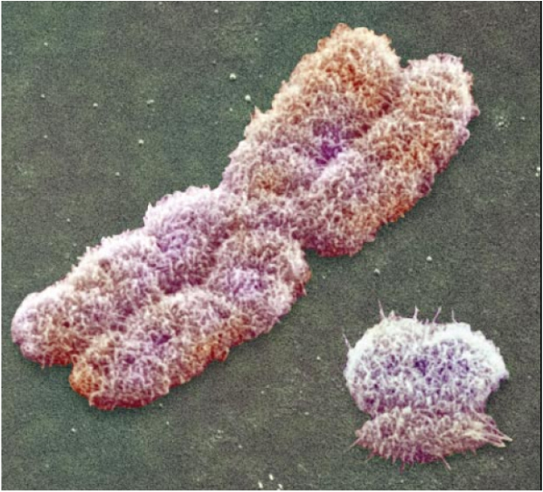
Human Heredity

Slide 2
Chromosomes and Classical Genetics
Walter Sutton in 1902 proposed that chromosomes were the physical carriers of Mendel's alleles
Problems arose however regarding the following question:
Why are the number of alleles which undergo independent assortment greater than the number of chromosomes of an organism?
This was explained by the understanding of 2 additional factors; Sex Linkage and crossing over

Slide 3
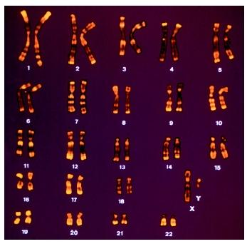
Human Chromosome
46 total; 23 from each parent
Two are known as the sex chromosomes, because they determine the zygotes sex
Females; “XX”
Males; “XY”
All other chromosomes are known as autosomes
Karyotype

Slide 4
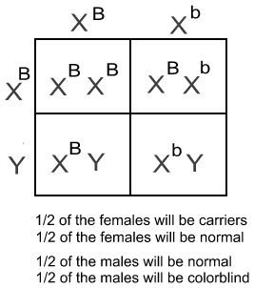
Human Chromosome
Meiosis results in gametes that produce sperm and egg cells by reducing the daughter chromosome by half.
All human egg cells carry a single X chromosome (23,X)
Half of all sperm cells carry an X chromosome and the other half carries a Y
50:50 Ratio

Slide 5
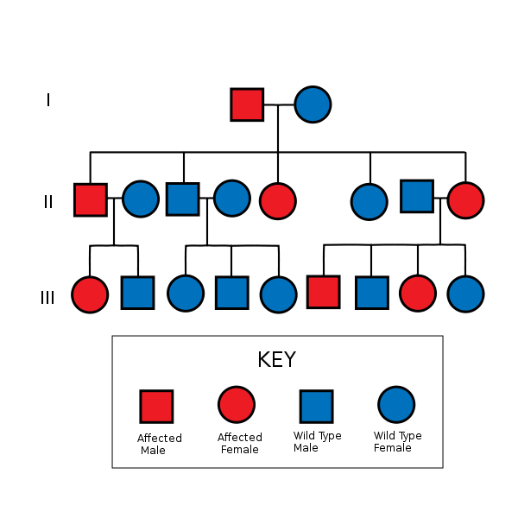
Human Traits
Heterochromia
Different colored eyes in the same person.
Autosomal Dominance
you only need to get the abnormal gene from one parent in order for you to inherit the disease. One of the parents may often have the disease.

Slide 6
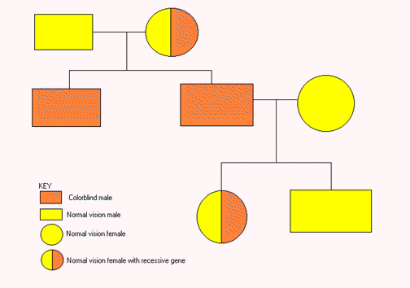
Human Traits
Pedigree-chart that shows the relationship of different traits within a family
Used by genetic counselors to infer the genotypes of family members
Color Blindness

Slide 7
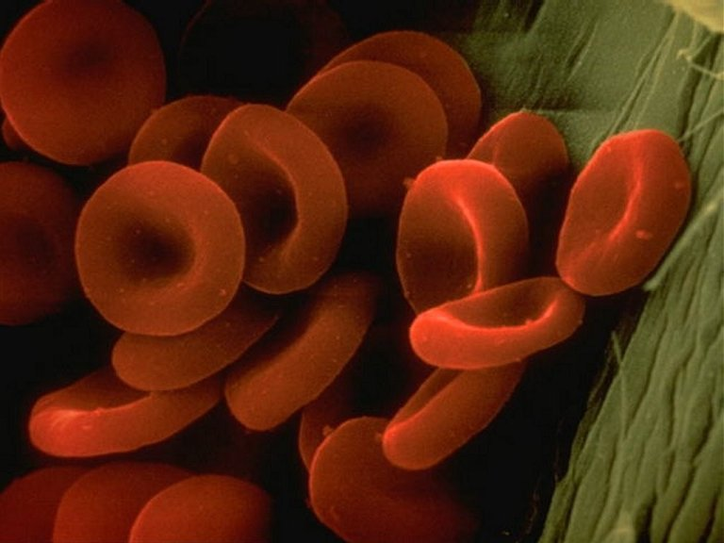
Blood Group Genes

Slide 8
Blood Typing: Two Groups
ABO Blood Groups
Rh Blood Group
Contains three alleles on a single gene
I^{A}, I^{B}, and i
I^{A} and I^{B} are codominant
i is recessive
All alleles except i contain antigens, this is what determines blood type
Determined by a positive or negative allele on a single gene
Positive Rh (Rh+) is dominant
Rh+/Rh+ or Rh+/Rh-
Rh-/Rh-, has a negative Rh

Slide 9
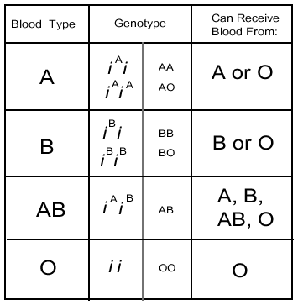
Antigens
Alleles expressed as genotypes
Donors
No Antigens

Slide 10
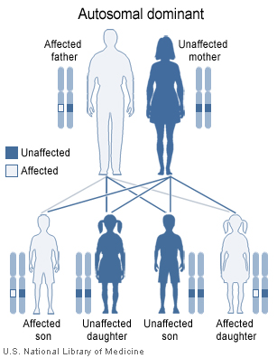
Genetic Disorders and Alleles

Slide 11
Autosomal Disorders
Autosomal Reccessive
ONLY discovered when an abnormal or non-functioning allele affects a phenotype
Phenylketonuria (PKU)
Tay-Sachs diseases
Autosomal Dominant
If you have a dominant allele for a genetic disorder it WILL be expressed
Achondroplasia (dwarfism)
Huntington’s Disease
**Be Familiar w/Disorders on Fig. 14-6 pg. 345**

Slide 12
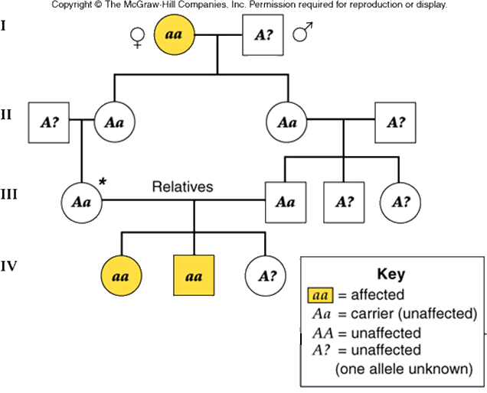
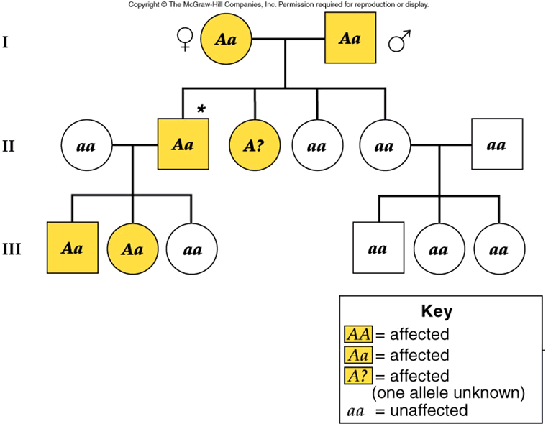
Autosomal Disorders
Autosomal Recessive
Autosomal Dominant

Slide 13
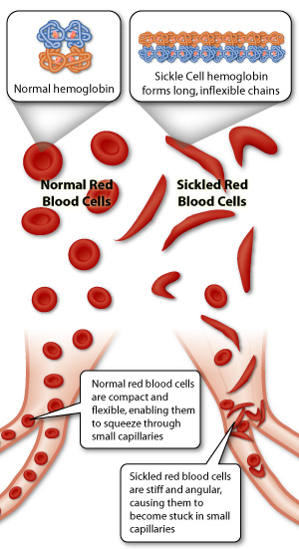
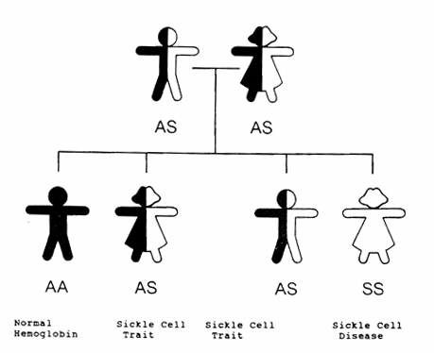
Genetic Disorders and Proteins
Sickle Cell Disease
Caused by a codominant allele on a single gene
Changes valine to glutamic acid

Slide 14
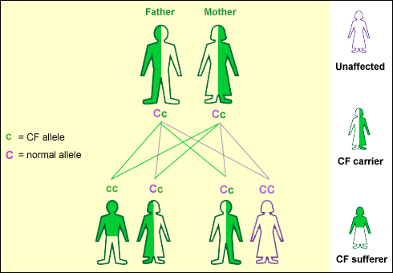
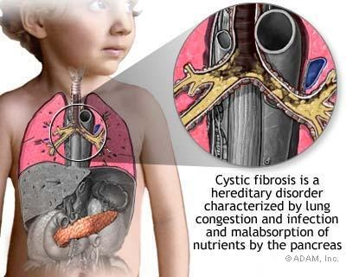
Genetic Disorders and Proteins
Cystic Fibrosis
Caused by a recessive allele on chromosome 7
Causes improper folding of protein molecules responsible for membrane transport of Cl⁻

Slide 15
Sex Linkage
Chromosome pairs of approximately the same length, centromere position, and staining pattern, with genes for the same characteristics
All chromosomes are homologous except on sex chromosomes.
Sex chromosomes are either X or Y.
If an organism is XX, it is a female, if XY it is male.
If a recessive allele exists on the X chromosome. It will not have a corresponding allele on the Y chromosome, and will therefore always be expressed

Slide 16
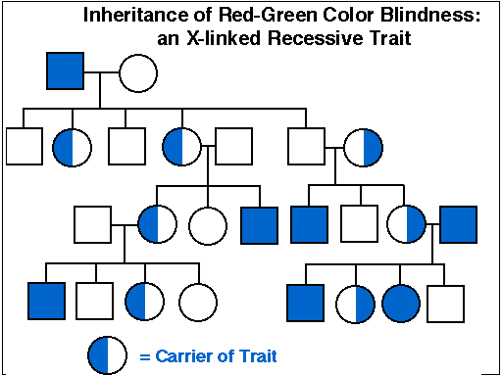
Human Sex Linkage
Three human genes for color vision are located on the X chromosome
If ANY alleles are defective it will show up in males (1 in 10)
If a female receives the recessive X chromosome. It will usually not be expressed since she carries an X chromosome with the normal gene (1 in 100)

Slide 17
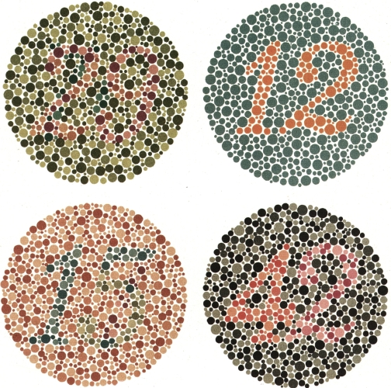
T
E
S
T

Slide 18
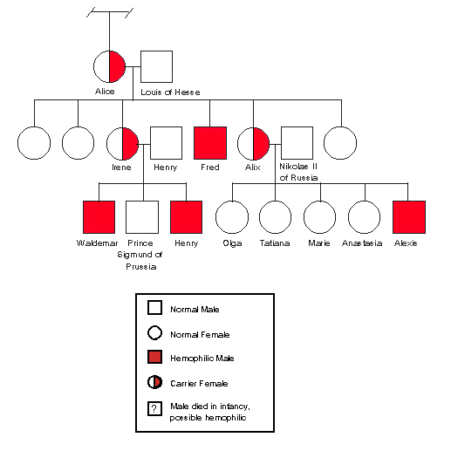
Human Sex Linkage
Hemophilia:
Disorder of the blood where clotting does not occur properly due to a faulty protein.
Occurs on the X chromosome, and is recessive.
Thus a vast majority of those affected are males.
First known person known to carry the disorder was Queen Victoria of England. Thus all those affected are related to European royalty.

Slide 19
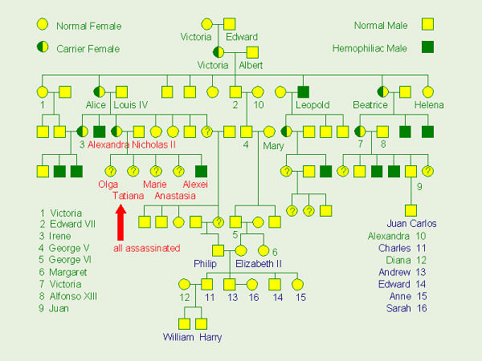
Hemophilia and Royalty

Slide 20
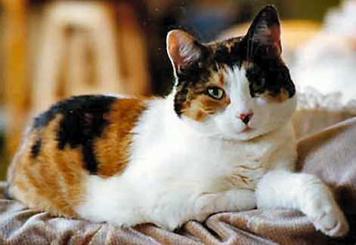
X-Chromosomal Inactivation
One X chromosome is randomly switched off in females to “adjust” to being paired with another X
The “off” X contains a barr body; a dense region around the nucleus
Reason for multi-colors “calico” in female cats
In rare instances, a calico cat can be a male. In this situation, the cat has two X chromosomes and one Y chromosome (XXY). Cats with this chromosomal configuration are usually sterile (not able to breed). They might have some value for their rarity, but not for breeding purposes.

Slide 21
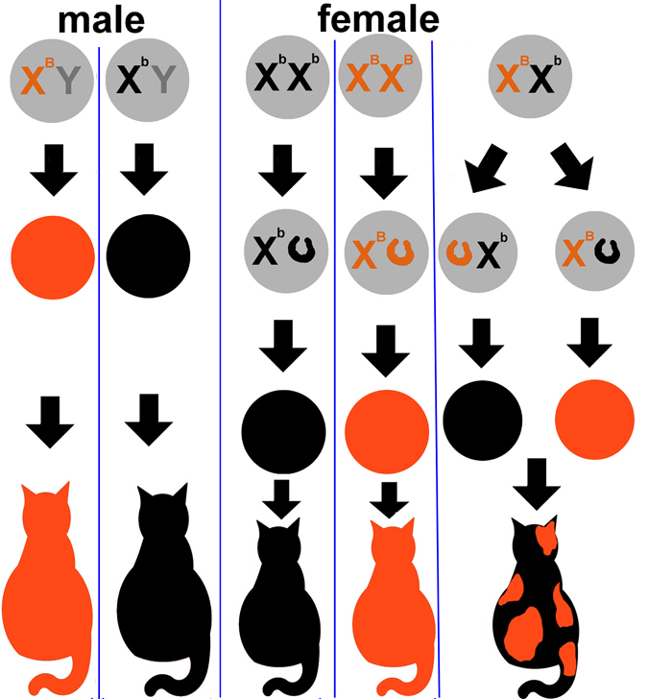

Slide 22
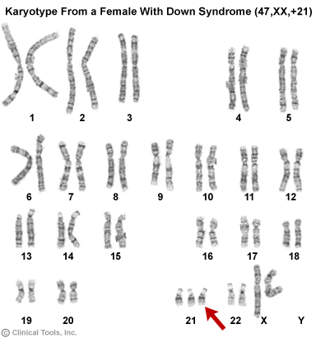
Chromosomal Disorder: Autosomes
NONDISJUNCTION
When homologous chromosomes FAIL TO SEPARATE during meiosis
Down Syndrome; 21st autosomal chromosome failed to separate therefore it has 3 copies (trisomy 21)

Slide 23
Chromosomal Disorder: Sex
Turner’s Syndrome
Klinefelter’s Syndrome
Caused by nondisjunction
Female will only inherit an X chromosome (karyotype 45,X)
Females are sterile because of underdeveloped sex organs
Caused by nondisjunction
Males have an extra X chromosome (karyotype 47, XXY)
Males are usually sterile as a result

Slide 24
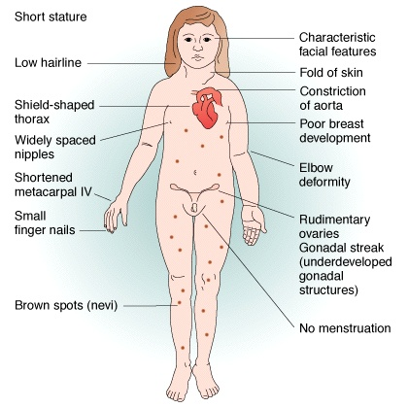
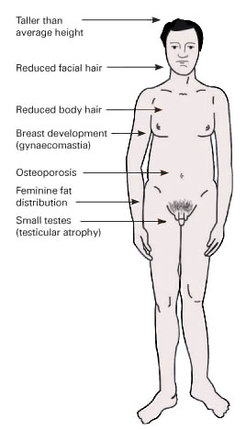
Chromosomal Disorder: Sex
Turner’s Syndrome
Klinefelter’s Syndrome

Slide 25
DNA Fingerprinting
DNA fingerprinting is a technique that is used to identify patterns that occur in DNA. No two organisms have identical DNA so this procedure can be used to identify if a sample of DNA came from a particular individual.
One of the most common techniques is Gel Electrophoresis.
Electrophoresis is a technique used to separate the DNA fragments according to their size. They are placed on a sheet of gelatin and an electric current is applied to the sheet. DNA is charged and will move in an electric field toward the positive pole.

Slide 26
DNA Samples from a crime scene and suspects
Which suspect is the one who commited the crime?

