Slide 1
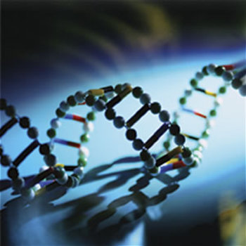
DNA and RNA

Slide 2
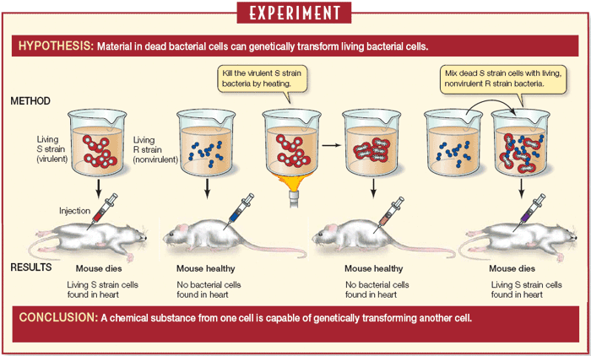
Scientific Contributions
Griffith and Transformation

Slide 3
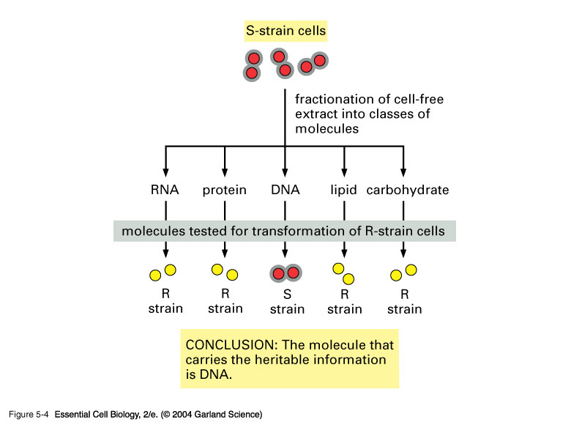
Avery and DNA

Slide 4
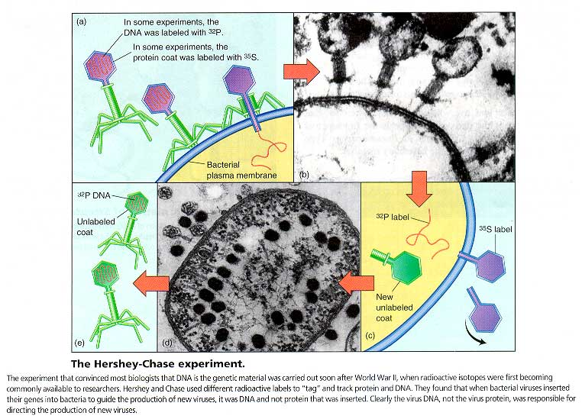
Hershey and Chase
Bacteriophage-virus that infects bacteria

Slide 5
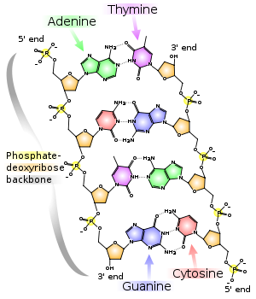
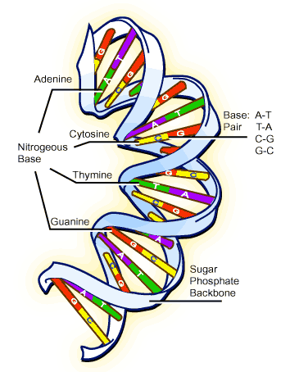
Components and Structure of DNA

Slide 6
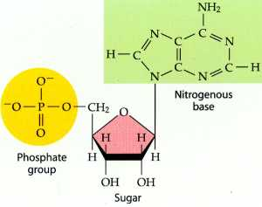
Nucleotide
One of four nitrogenous bases
Phosphate group
5-carbon sugar

Slide 9
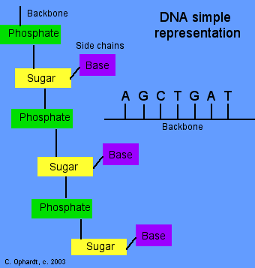
DNA Primary Structure Summary
Backbone (sugar+phophate) and base side chains

Slide 10
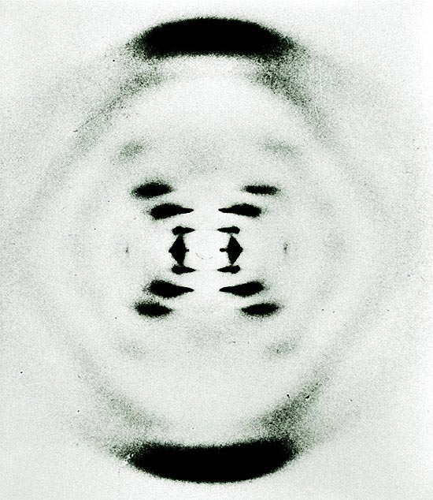
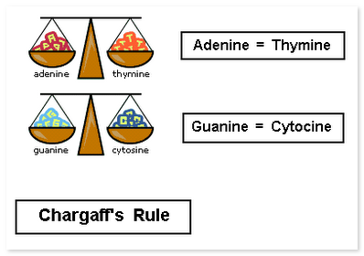
Discovering DNA’s Complexity
Chargaff’s Rule
Rosalind Franklin
X-Ray Diffraction

Slide 11
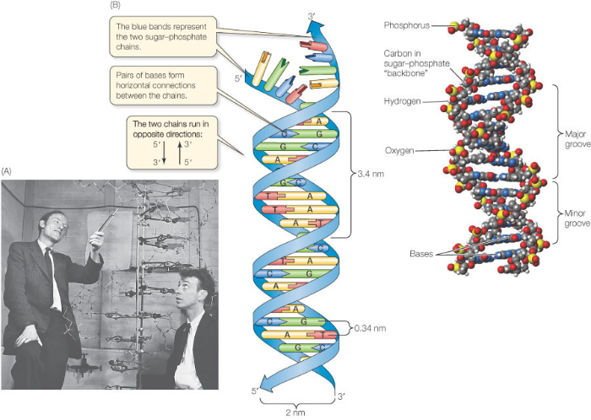
Watson and Crick

Slide 13
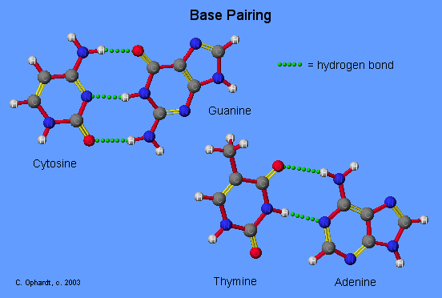
DNA Double Helix
Rule of Base pairing
Hydrogen bonds pair C - G and A - T

Slide 14
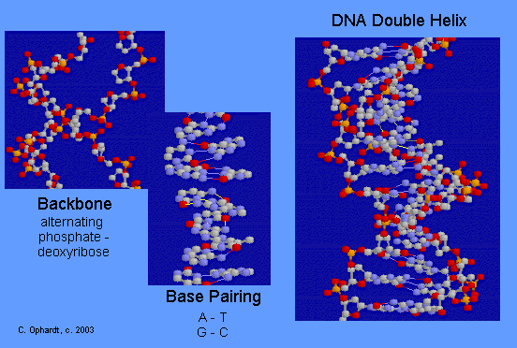
DNA Double Helix
Base pairing by unique hydrogen bonds
C - G and A - T pairs

