Slide 1
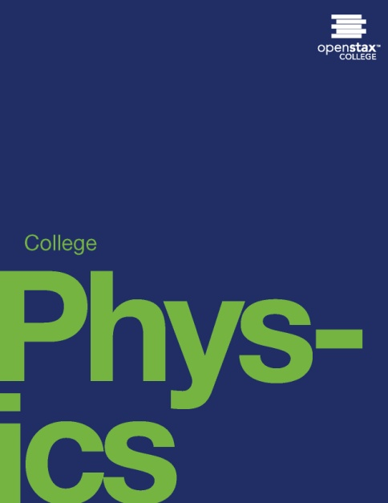
College Physics
Chapter 1 INTRODUCTION: THE NATURE OF SCIENCE AND PHYSICS
PowerPoint Image Slideshow

Slide 2
Figure 1.1
Galaxies are as immense as atoms are small. Yet the same laws of physics describe both, and all the rest of nature—an indication of the underlying unity in the universe. The laws of physics are surprisingly few in number, implying an underlying simplicity to nature’s apparent complexity. (credit: NASA, JPL-Caltech, P. Barmby, Harvard Smithsonian Center for Astrophysics)

Slide 3
Figure 1.2
The flight formations of migratory birds such as Canada geese are governed by the laws of physics. (credit: David Merrett)

Slide 4
Figure 1.3
The Apple “iPhone” is a common smart phone with a GPS function. Physics describes the way that electricity flows through the circuits of this device. Engineers use their knowledge of physics to construct an iPhone with features that consumers will enjoy. One specific feature of an iPhone is the GPS function. GPS uses physics equations to determine the driving time between two locations on a map. (credit: @gletham GIS, Social, Mobile Tech Images)

Slide 5
Figure 1.4
The laws of physics help us understand how common appliances work. For example, the laws of physics can help explain how microwave ovens heat up food, and they also help us understand why it is dangerous to place metal objects in a microwave oven. (credit: MoneyBlogNewz)

Slide 6
Figure 1.5
These two applications of physics have more in common than meets the eye. Microwave ovens use electromagnetic waves to heat food. Magnetic resonance imaging (MRI) also uses electromagnetic waves to yield an image of the brain, from which the exact location of tumors can be determined. (credit: Rashmi Chawla, Daniel Smith, and Paul E. Marik)

Slide 7
Figure 1.6
Physics, chemistry, and biology help describe the properties of cell walls in plant cells, such as the onion cells seen here. (credit: Umberto Salvagnin)

Slide 8
Figure 1.7
An artist’s rendition of the the structure of a cell membrane. Membranes form the boundaries of animal cells and are complex in structure and function. Many of the most fundamental properties of life, such as the firing of nerve cells, are related to membranes. The disciplines of biology, chemistry, and physics all help us understand the membranes of animal cells. (credit: Mariana Ruiz)

Slide 9
Figure 1.8
Isaac Newton (1642–1727) was very reluctant to publish his revolutionary work and had to be convinced to do so. In his later years, he stepped down from his academic post and became exchequer of the Royal Mint. He took this post seriously, inventing reeding (or creating ridges) on the edge of coins to prevent unscrupulous people from trimming the silver off of them before using them as currency. (credit: Arthur Shuster and Arthur E. Shipley: Britain’s Heritage of Science. London, 1917.)

Slide 10
Figure 1.9
Marie Curie (1867–1934) sacrificed monetary assets to help finance her early research and damaged her physical well-being with radiation exposure. She is the only person to win Nobel prizes in both physics and chemistry. One of her daughters also won a Nobel Prize. (credit: Wikimedia Commons)

Slide 11
Figure 1.10
What is a model? This planetary model of the atom shows electrons orbiting the nucleus. It is a drawing that we use to form a mental image of the atom that we cannot see directly with our eyes because it is too small.

Slide 12
Figure 1.11
Over the centuries, natural philosophy has evolved into more specialized disciplines, as illustrated by the contributions of some of the greatest minds in history. The Greek philosopher Aristotle (384–322 B.C.) wrote on a broad range of topics including physics, animals, the soul, politics, and poetry. (credit: Jastrow (2006)/Ludovisi Collection)

Slide 13
Figure 1.12
Galileo Galilei (1564–1642) laid the foundation of modern experimentation and made contributions in mathematics, physics, and astronomy. (credit: Domenico Tintoretto)

Slide 14
Figure 1.13
Niels Bohr (1885–1962) made fundamental contributions to the development of quantum mechanics, one part of modern physics. (credit: United States Library of Congress Prints and Photographs Division)

Slide 15
Figure 1.14
Using a scanning tunneling microscope (STM), scientists can see the individual atoms that compose this sheet of gold. (credit: Erwinrossen)

Slide 16
Figure 1.16
The distance from Earth to the Moon may seem immense, but it is just a tiny fraction of the distances from Earth to other celestial bodies. (credit: NASA)

Slide 17
Figure 1.17
Distances given in unknown units are maddeningly useless.

Slide 18
Figure 1.18
An atomic clock such as this one uses the vibrations of cesium atoms to keep time to a precision of better than a microsecond per year. The fundamental unit of time, the second, is based on such clocks. This image is looking down from the top of an atomic fountain nearly 30 feet tall! (credit: Steve Jurvetson/Flickr)

Slide 19
Figure 1.19
The meter is defined to be the distance light travels in 1/299,792,458 of a second in a vacuum. Distance traveled is speed multiplied by time.

Slide 20
Figure 1.20
Tiny phytoplankton swims among crystals of ice in the Antarctic Sea. They range from a few micrometers to as much as 2 millimeters in length. (credit: Prof. Gordon T. Taylor, Stony Brook University; NOAA Corps Collections)

Slide 21
Figure 1.21
Galaxies collide 2.4 billion light years away from Earth. The tremendous range of observable phenomena in nature challenges the imagination. (credit: NASA/CXC/UVic./A. Mahdavi et al. Optical/lensing: CFHT/UVic./H. Hoekstra etb al.)

Slide 22
Figure 1.22
A double-pan mechanical balance is used to compare different masses. Usually an object with unknown mass is placed in one pan and objects of known mass are placed in the other pan. When the bar that connects the two pans is horizontal, then the masses in both pans are equal. The “known masses” are typically metal cylinders of standard mass such as 1 gram, 10 grams, and 100 grams. (credit: Serge Melki)

Slide 23
Figure 1.23
Many mechanical balances, such as double-pan balances, have been replaced by digital scales, which can typically measure the mass of an object more precisely. Whereas a mechanical balance may only read the mass of an object to the nearest tenth of a gram, many digital scales can measure the mass of an object up to the nearest thousandth of a gram. (credit: Karel Jakubec)

Slide 24
Figure 1.24
A GPS system attempts to locate a restaurant at the center of the bull’s-eye. The black dots represent each attempt to pinpoint the location of the restaurant. The dots are spread out quite far apart from one another, indicating low precision, but they are each rather close to the actual location of the restaurant, indicating high accuracy.(credit: Dark Evil)

Slide 25
Figure 1.25
In this figure, the dots are concentrated rather closely to one another, indicating high precision, but they are rather far away from the actual location of the restaurant, indicating low accuracy. (credit: Dark Evil)

Slide 26
Figure 1.27
A bank stack contains one-hundred $100 bills, and is worth $10,000. How many bank stacks make up a trillion dollars? (credit: Andrew Magill)

Slide 27
Figure 1.28
This color-enhanced photo shows Salmonella typhimurium (red) attacking human cells. These bacteria are commonly known for causing foodborne illness. Can you estimate the number of atoms in each bacterium? (credit: Rocky Mountain Laboratories, NIAID, NIH)

Slide 28
This PowerPoint file is copyright 2011-2013, Rice University. All Rights Reserved.

