Slide 1
Work, Energy, & Power
A PowerPoint Presentation by
Paul E. Tippens, Professor of Physics
Southern Polytechnic State University
© 2007

Slide 2
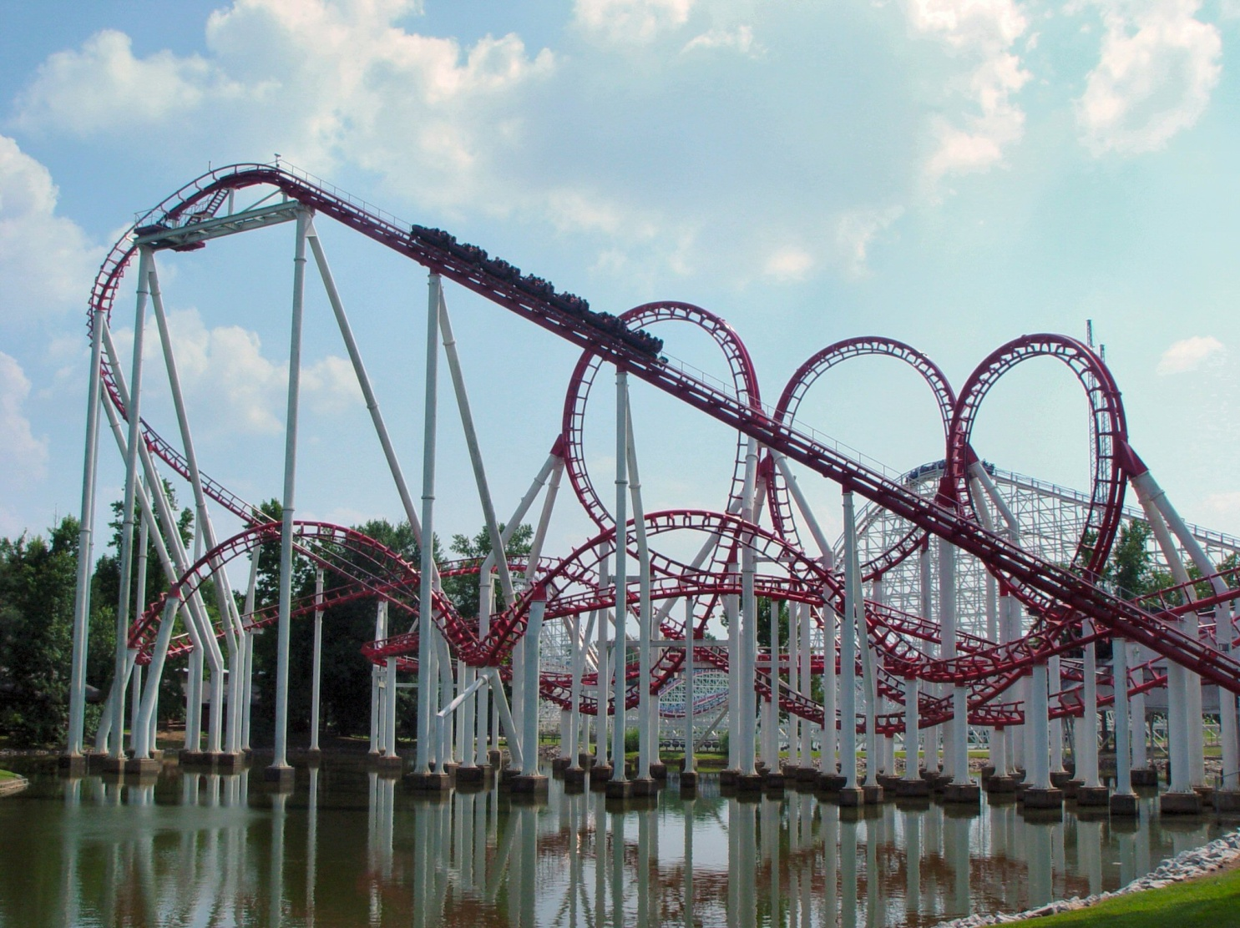
The Ninja, a roller coaster at Six Flags over Georgia, has a height of 122 ft and a speed of 52 mi/h. The potential energy due to its height changes into kinetic energy of motion.

Slide 3
Objectives: After completing this module, you should be able to:
Define kinetic energy and potential energy, along with the appropriate units in each system.
Describe the relationship between work and kinetic energy, and apply the WORK-ENERGY THEOREM.
Define and apply the concept of POWER, along with the appropriate units.

Slide 4
Energy
Energy is anything that can be con-verted into work; i.e., anything that can exert a force through a distance.
Energy is the capability for doing work.

Slide 5
Potential Energy
Potential Energy: Ability to do work by virtue of position or condition.
A suspended weight
A stretched bow

Slide 6
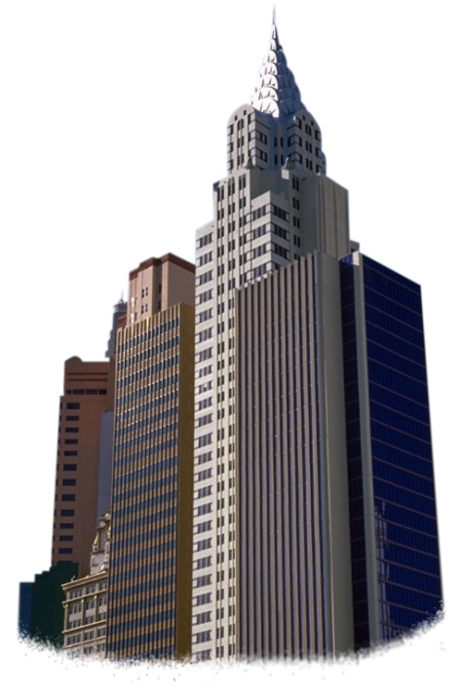
Example Problem: What is the potential energy of a 50-kg person in a skyscraper if he is 480 m above the street below?
Gravitational Potential Energy
What is the P.E. of a 50-kg person at a height of 480 m?
U = mgh = (50 kg)(9.8 m/s²)(480 m)
U = 235 kJ

Slide 7
Kinetic Energy
Kinetic Energy: Ability to do work by virtue of motion. (Mass with velocity)
A speeding car or a space rocket

Slide 8
Examples of Kinetic Energy
What is the kinetic energy of a 5-g bullet traveling at 200 m/s?
5 g
K = 100 J
200 m/s
What is the kinetic energy of a 1000-kg car traveling at 14.1 m/s?
K = 99.4 J

Slide 9
Work and Kinetic Energy
A resultant force changes the velocity of an object and does work on that object.
x
v_{f}
v_{o}
F
F
m
m

Slide 10
The Work-Energy Theorem
Work is equal to the change in ½mv²
If we define kinetic energy as ½mv² then we can state a very important physical principle:
The Work-Energy Theorem: The work done by a resultant force is equal to the change in kinetic energy that it produces.

Slide 11
Example 1: A 20-g projectile strikes a mud bank, penetrating a distance of 6 cm before stopping. Find the stopping force F if the entrance velocity is 80 m/s.
6 cm
0
80 m/s
x
Work = ½ mv_{f}² - ½ mv_{o}²
F x = - ½ mv_{o}²
F = ?
F (0.06 m) cos 180⁰ = - ½ (0.02 kg)(80 m/s)²
F (0.06 m)(-1) = -64 J
F = 1067 N
Work to stop bullet = change in K.E. for bullet

Slide 12
Example 2: A bus slams on brakes to avoid an accident. The tread marks of the tires are 80 m long. If μ_{k} = 0.7, what was the speed before applying brakes?
Work = ΔK
Work = F(cos θ) x
25 m
f
f = μ_{k.}n = μ_{k} mg
0
Work = - μ_{k} mg x
ΔK = ½ mv_{f}² - ½ mv_{o}²
-½ mv_{o}² = -μ_{k} mg x
ΔK = Work
v_{o} = 2μ_{k}gx
v_{o} = 2(0.7)(9.8 m/s²)(25 m)
v_{o} = 59.9 ft/s

Slide 13
Example 3: A 4-kg block slides from rest at top to bottom of the 30⁰ inclined plane. Find velocity at bottom. (h = 20 m and μ_{k} = 0.2)
Plan: We must calculate both the resultant work and the net displacement x. Then the velocity can be found from the fact that Work = ΔK.
f
n
x
h
mg
30⁰
Resultant work = (Resultant force down the plane) x (the displacement down the plane)

Slide 14
Example 3 (Cont.): We first find the net displacement x down the plane:
f
n
x
x
h
h
mg
30⁰
30⁰
From trig, we know that the Sin 30⁰ = h/x and:

Slide 15
Example 3(Cont.): Next we find the resultant work on 4-kg block. (x = 40 m and μ_{k} = 0.2)
Draw free-body diagram to find the resultant force:
f
y
x = 40 m
n
f
n
mg sin 30⁰
mg cos 30⁰
h
x
mg
30⁰
30⁰
mg
W_{x} = (4 kg)(9.8 m/s²)(sin 30⁰) = 19.6 N
W_{y} = (4 kg)(9.8 m/s²)(cos 30⁰) = 33.9 N

Slide 16
Example 3(Cont.): Find the resultant force on 4-kg block. (x = 40 m and μ_{k} = 0.2)
y
Resultant force down plane: 19.6 N - f
f
n
19.6 N
Recall that f_{k} = μ_{k} n
33.9 N
x
mg
ΣF_{y} = 0 or n = 33.9 N
30⁰
Resultant Force = 19.6 N – μ_{k}n ; and μ_{k} = 0.2
Resultant Force = 19.6 N – (0.2)(33.9 N) = 12.8 N
Resultant Force Down Plane = 12.8 N

Slide 17
Example 3 (Cont.): The resultant work on 4-kg block. (x = 40 m and F_{R} = 12.8 N)
(Work)_{R} = F_{R}x
x
Net Work = (12.8 N)(40 m)
F_{R}
30⁰
Net Work = 512 J
Finally, we are able to apply the work-energy theorem to find the final velocity:
0

Slide 18
Example 3 (Cont.): A 4-kg block slides from rest at top to bottom of the 30⁰ plane. Find velocity at bottom. (h = 20 m and μ_{k} = 0.2)
f
n
x
Resultant Work = 512 J
h
Work done on block equals the change in K. E. of block.
mg
30⁰
0
½ mv_{f}² - ½ mv_{o}² = Work
½ mv_{f}² = 512 J
½(4 kg)v_{f}² = 512 J
v_{f} = 16 m/s

Slide 19
Power
Power is defined as the rate at which work is done: (P = dW/dt )
t
F
m
4 s
10 kg
h
mg
20 m
Power of 1 W is work done at rate of 1 J/s

Slide 20
Units of Power
One watt (W) is work done at the rate of one joule per second.
1 W = 1 J/s and 1 kW = 1000 W
One ft lb/s is an older (USCS) unit of power.
One horsepower is work done at the rate of 550 ft lb/s. ( 1 hp = 550 ft lb/s )

Slide 21
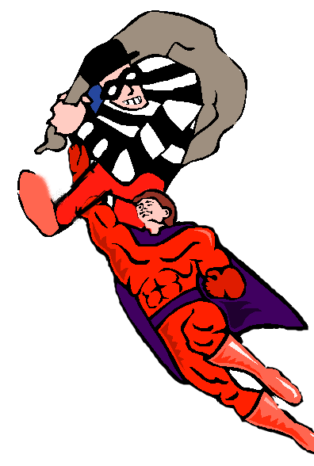
Example of Power
What power is consumed in lifting a 70-kg robber 1.6 m in 0.50 s?
Power Consumed: P = 2220 W

Slide 22
Example 4: A 100-kg cheetah moves from rest to 30 m/s in 4 s. What is the power?
Recognize that work is equal to the change in kinetic energy:
m = 100 kg
Power Consumed: P = 1.22 kW

Slide 23
Power and Velocity
Recall that average or constant velocity is distance covered per unit of time v = x/t.
F x
t
x
t
P = = F
If power varies with time, then calculus is needed to integrate over time. (Optional)
Since P = dW/dt:

Slide 24
Example 5: What power is required to lift a 900-kg elevator at a constant speed of 4 m/s?
v = 4 m/s
P = F v = mg v
P = (900 kg)(9.8 m/s²)(4 m/s)
P = 35.3 kW

Slide 25
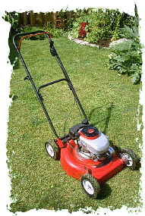
Example 6: What work is done by a 4-hp mower in one hour? The conversion factor is needed: 1 hp = 550 ft lb/s.
Work = 132,000 ft lb

Slide 26
Summary
Potential Energy: Ability to do work by virtue of position or condition.
Kinetic Energy: Ability to do work by virtue of motion. (Mass with velocity)
The Work-Energy Theorem: The work done by a resultant force is equal to the change in kinetic energy that it produces.
Work = ½ mv_{f}² - ½ mv_{o}²

Slide 27
Summary (Cont.)
Power is defined as the rate at which work is done: (P = dW/dt )
P= F v
Power of 1 W is work done at rate of 1 J/s

Slide 28
CONCLUSION:
Work and Energy

